Slide 1
Predicting Biomechanical Outcomes of Sit-to-stand with Direct Collocation
Team members
Mikayla Schneider 👩🔧, Soyong Shin 👨🔧, and Vu Phan 👨🔧
Project Presentation
Carnegie Mellon University
Spring 2023

Slide 2
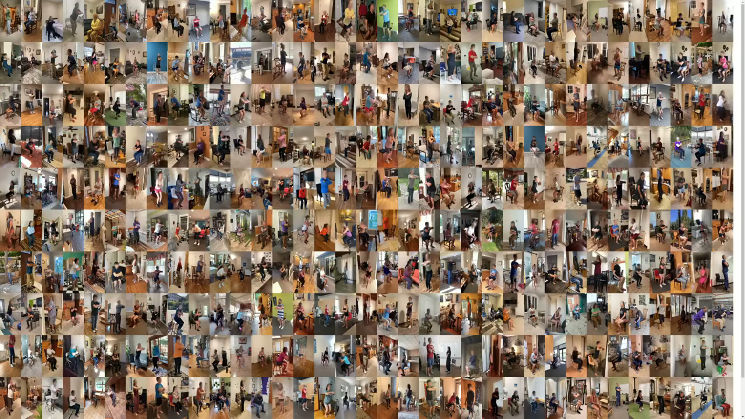
Why do we care about sit-to-stand?
Very common in real life
Typical test used by clinicians
Easy to perform
Boswell et al., npj Digital Medicine (2023)

Slide 3
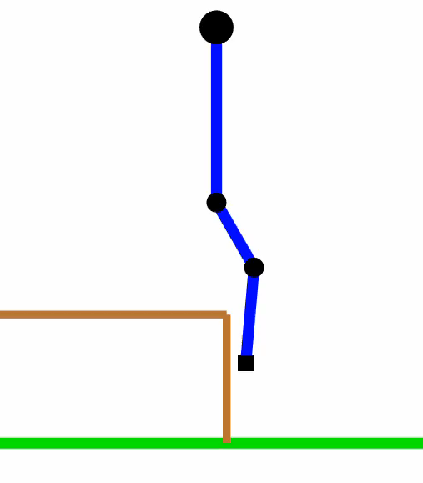
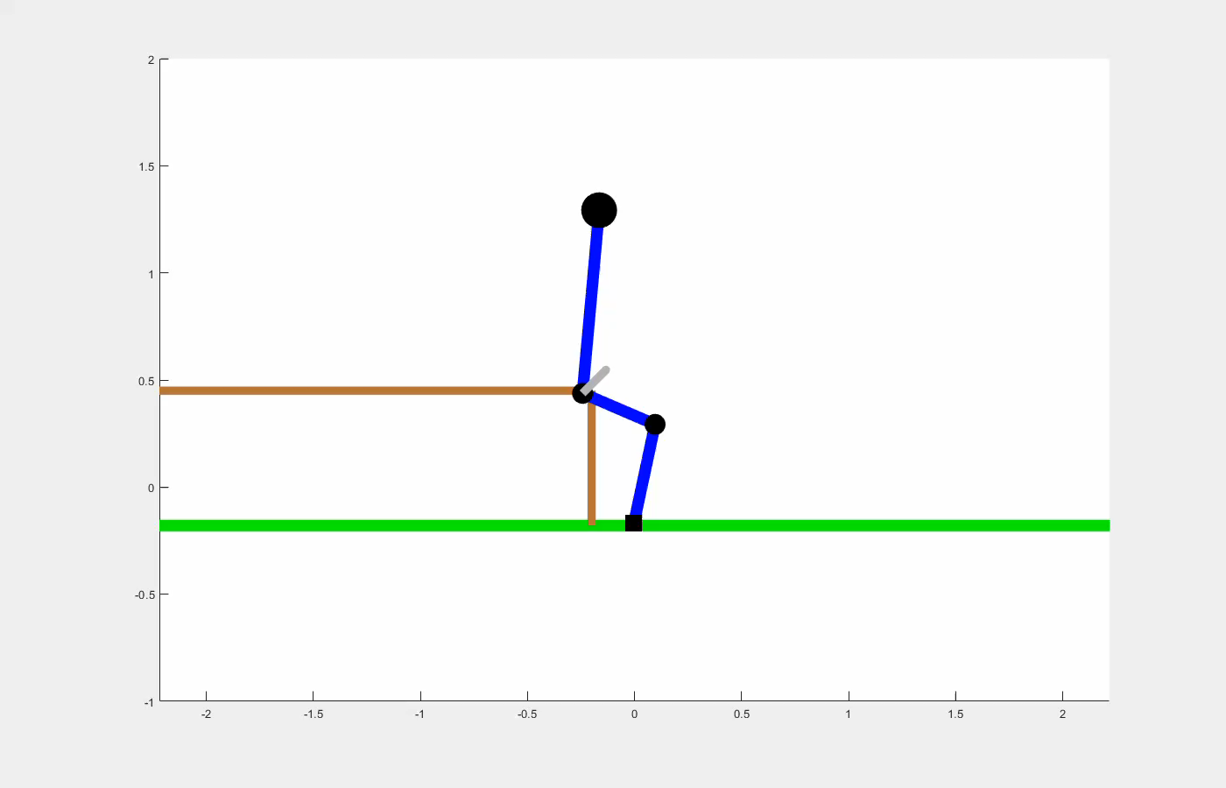
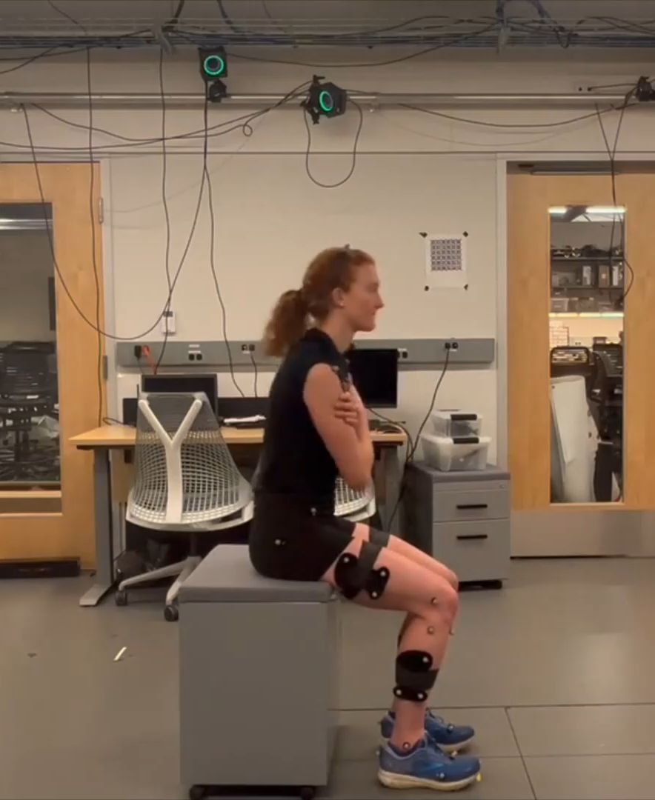
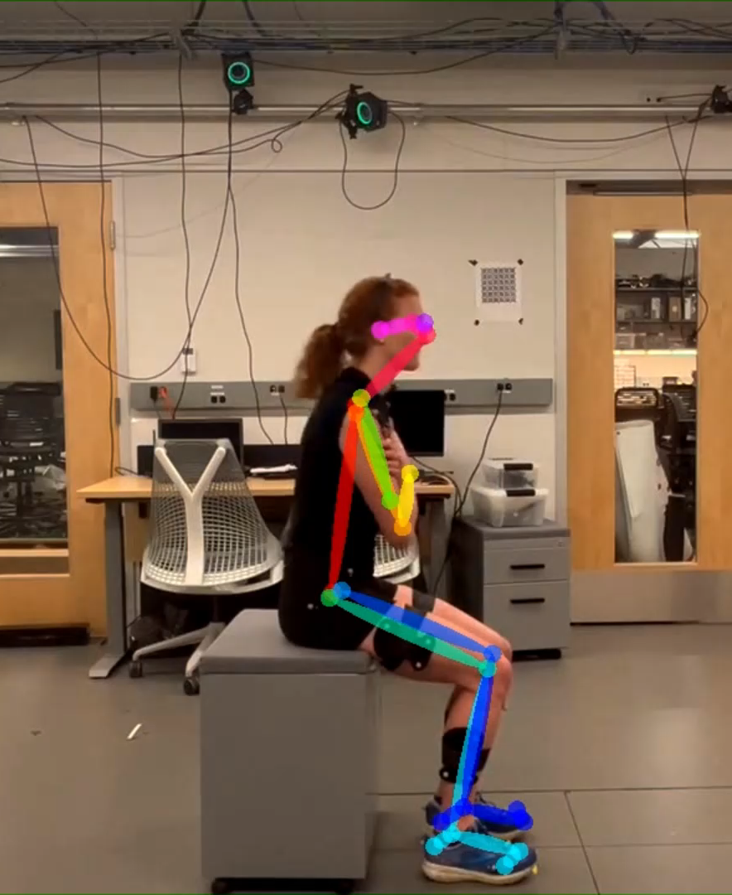
Our proposal
F = m.a
Model
Biomechanical constraints, etc.
Modeling
Simulation
Biomechanics
Mass, inertia, length, etc. of each body segment
Rajagopal et al., IEEE Transactions on Biomedical Engineering (2016)
Biomechanics
de Leva, Journal of Biomechanics (1996)
Direct collocation
Outcomes
Previous approach
📱
Smartphone
Record video
Video
OpenPose
Reference state
Kinematics
Joint angles
Kinetics
Joint torques
Kinematics
Forces
Boswell et al., npj Digital Medicine (2023)

Slide 4
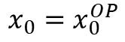
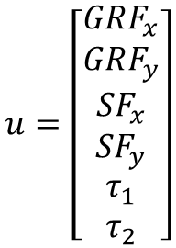
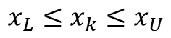
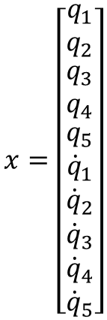
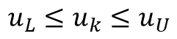
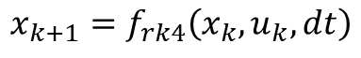

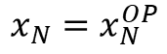
Optimal control problem
OpenPose state
$$x=\left[\begin{matrix}q_{1} \\ q_{2} \\ \begin{matrix}q_{3} \\ q_{4} \\ \begin{matrix}q_{5} \\ {\dot{q}}_{1} \\ \begin{matrix}{\dot{q}}_{2} \\ {\dot{q}}_{3} \\ \begin{matrix}{\dot{q}}_{4} \\ {\dot{q}}_{5}\end{matrix}\end{matrix}\end{matrix}\end{matrix}\end{matrix}\right]$$
Hip position X (global frame)
Hip position Y (global frame)
Trunk angle (global frame)
Hip angle
Knee angle
$$\min{\sum_{k=1}^{N−1}{\left[{\left(x_{k}−x_{k}^{OP}\right)}^{T}Q\left(x_{k}−x_{k}^{OP}\right)+u_{k}^{T}Ru_{k}\right]+{\left(x_{N}−x_{N}^{OP}\right)}^{T}Q(x_{N}−x_{N}^{OP})}}$$
Tracking cost
Effort cost
Initial state (sitting)
subject to
$$x_{0}=x_{0}^{OP}$$
Final state (standing)
$$u=\left[\begin{matrix}GRF_{x} \\ GRF_{y} \\ \begin{matrix}SF_{x} \\ SF_{y} \\ \begin{matrix}τ_{1} \\ τ_{2}\end{matrix}\end{matrix}\end{matrix}\right]$$
Ground reaction forces
$$x_{N}=x_{N}^{OP}$$
$$x_{L}≤x_{k}≤x_{U}$$
Biomechanical constraints on joint angles and torques
Seating forces
$$u_{L}≤u_{k}≤u_{U}$$
Hip torque
Knee torque
$${x_{k+1}=f}_{rk4}\left(x_{k},u_{k},dt\right)$$
Dynamic constraints

Slide 5
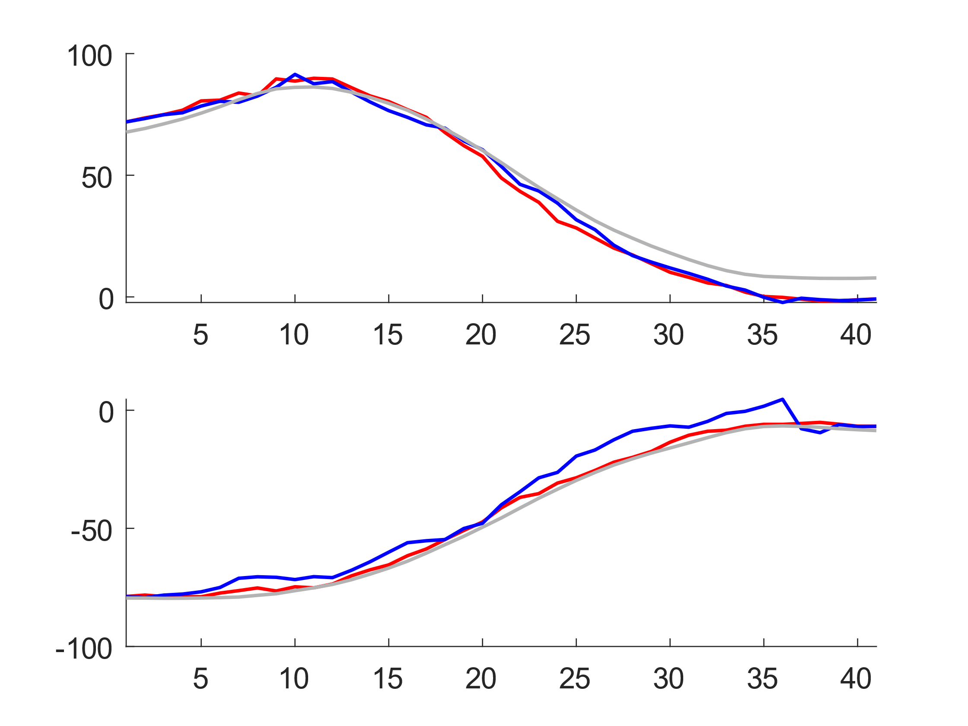
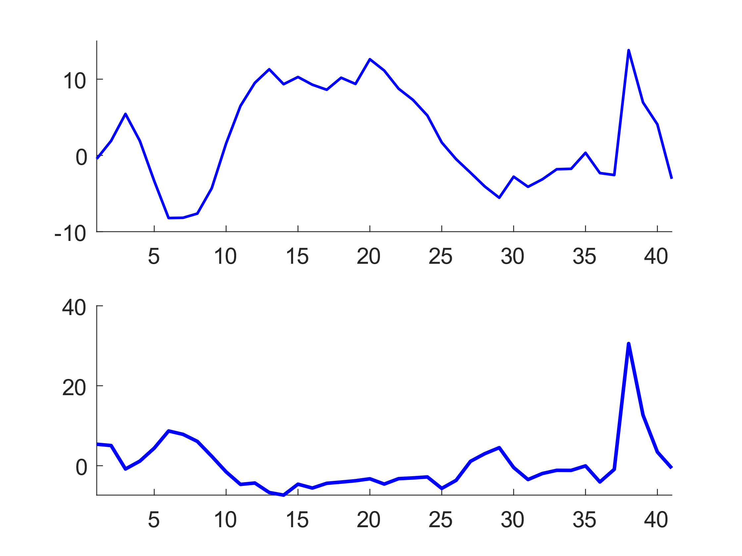
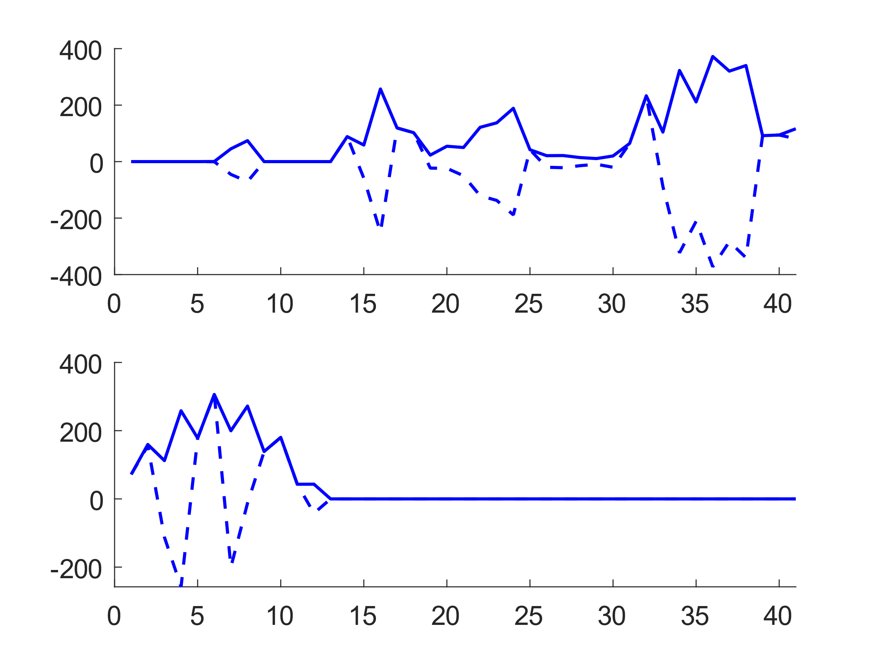
Results and Discussion
Ground truth (from mocap)
Kinematics tracking from OpenPose
Tracking from the dynamic model / y-axis (for forces)
x-axis (for forces)
Joint angles
Joint torques
Forces
RMSE_{model} = 5.11º
RMSE_{OpenPose} = 5.93º
Hip (º)
Hip (N.m)
GRF (N)
Knee (º)
RMSE_{model} = 6.49º
RMSE_{OpenPose} = 1.95º
Knee (N.m)
SF (N)
Samples

Slide 6
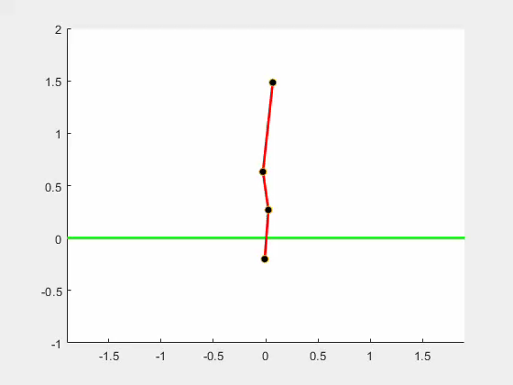
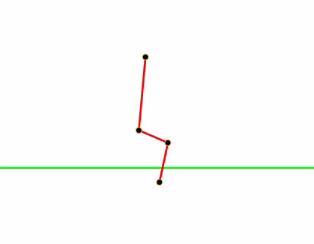
Future work
Improve the biomechanical model (e.g., foot contact model, biomechanical parameters/constraints, etc.)
Apply to 3-dimensional scenarios
Thank you for your listening!
Q&A
Meanwhile, below are our first few attempts before getting it to work 😅
No constraints
No contact
Too much constraints on standing
Too much constraints on sitting
Bad constraints

